Slide 2


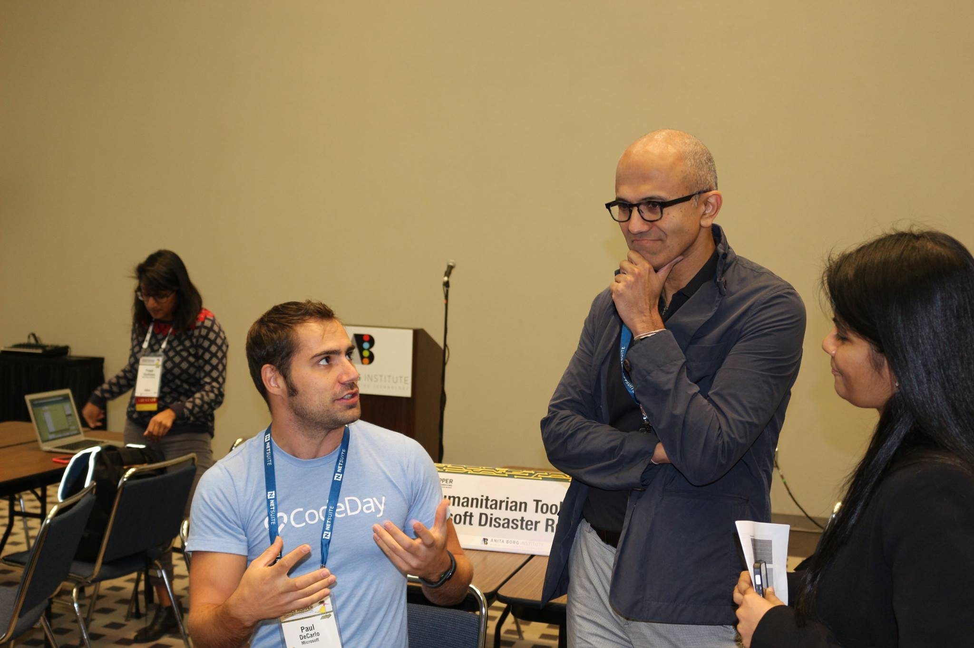
Who am I?
Paul DeCarlo | @pjdecarlo
Sr. Technology Evangelist
Blog pjdecarlo.com
pdecarlo@microsoft.com
Fun Stuff
Current Hometown of Houston, TX
Sing in a Tool tribute Band
Love the outdoors
Met Satya last year

Slide 3
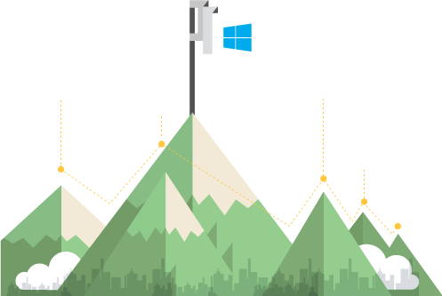








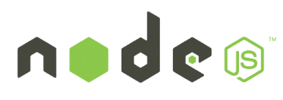






Azure is an open cloud
Any language and any data source in any operating system for any device
Add value to your Linux investments
Embrace open source DevOps
Bring the tools you use and love
Build hyperscale at hyperspeed
Notes:
Everyone’s datacenter right now has a little bit of everything—it’s evolved over time, with new technologies and standards cropping up at all times (OSS and proprietary alike). This isn’t a bad thing—but it’s a management challenge for sure. How do we expect to oversee and manage this ever-evolving set of technologies and, specifically, the non-centralized open source technologies that are now ubiquitous?
Take a look through these technologies—some obviously will look very familiar to you and your evolving datacenter:
Oracle
SAP
Linux
Office
Windows
NodeJS
Apple
Java
Android
PHP
Hadoop
MongoDB
SharePoint
Hadoop
SQL Server
Drupal
Joomla
WordPress
.NET
Python
Dropbox
DB2
Puppet
Chef
GitHub

Slide 4


Big ADJECTIVE 1. of considerable size, extent, or intensity:
“Space is big. You just won't believe how vastly, hugely, mind-bogglingly big it is. I mean, you may think it's a long way down the road to the chemist's, but that's just peanuts to space.”
― Douglas Adams, The Hitchhiker's Guide to the Galaxy
Notes:
Optional Slide – I use the quote about space being big and then bring in the Azure cloud and talk about how it is big as well and this session is going to help you navigate it

Slide 5



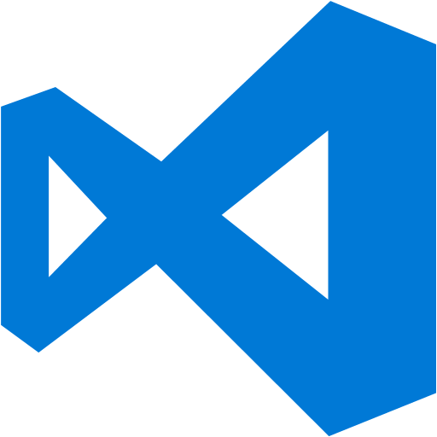














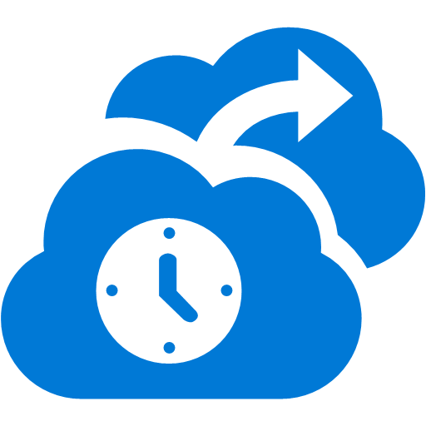














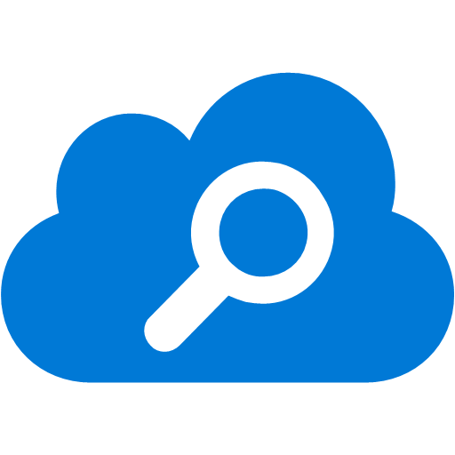


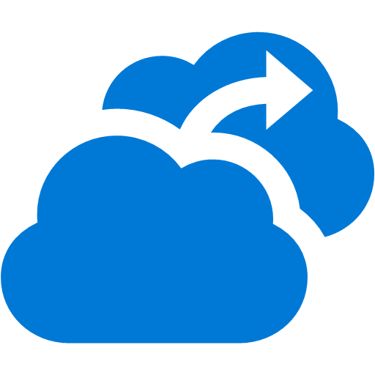


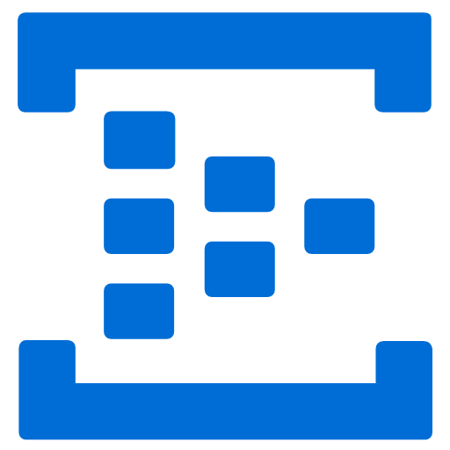










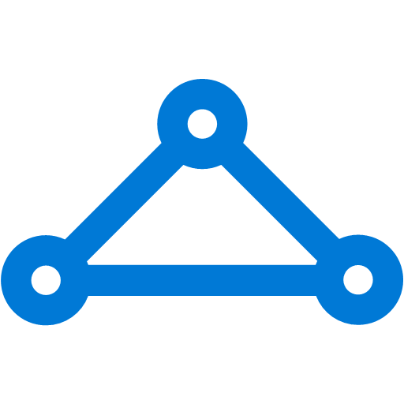



Platform Services
Security & Management
Compute
Web and Mobile
Developer Services
Hybrid
Operations
AppService
API
Management
Cloud
Services
Service
Fabric
Visual Studio
Azure SDK
Portal
Web
Apps
API
Apps
Mobile
Engagement
Azure AD
Connect Health
Batch
Remote App
Mobile
Apps
Logic
Apps
IoT Suite
Application
Insights
Active
Directory
Notification
Hubs
Team Project
AD Privileged
Identity
Management
Integration
Analytics & IoT
Data
Multi-Factor
Authentication
Power
BI
Backup
Storage
Queues
Biztalk
Services
Automation
HDInsight
IoT
Hub
SQL
Database
SQL Data
Warehouse
Operational
Insights
Hybrid
Connections
Service
Bus
Key Vault
Data
Factory
Machine
Learning
Redis
Cache
Search
Import/Export
Store /
Marketplace
Media & CDN
Site
Recovery
Media
Services
Content Delivery
Network (CDN)
Event
Hubs
Stream
Analytics
DocumentDB
Tables
VM Image Gallery
& VM Depot
StorSimple
Infrastructure Services
Compute
Storage
Networking
Virtual Machines
Containers
BLOB Storage
Azure Files
Premium Storage
Virtual Network
Load Balancer
DNS
Express
Route
Traffic Manager
VPN Gateway
Application Gateway
Datacenter Infrastructure (24 Regions, 19 Online)
Notes:
Why this Slide:
It shows we have a very broad platform. It about BOTH IaaS and PaaS, that these work together. It shows that we continue to lead in world class IT capabilities and that there’s really nothing missing.
Key Points:
We have already seen how the Azure Platform is IaaS + Pass – but I want you to understand that this is a huge number of capabilities – IT building blocks if you will.
Every one of these blocks you provision anytime, self-service anywhere in the world 24x7. You pay for what you use, you can get more or less anytime and you can fully automate everything…
DON’T spent too much time on this slide – you are going to DEMO (aren’t you!!!)… DON’T go through each block…
Transition to NEXT Slide: Make the build go backwards to show JUST IaaS and then you will go to the demo to show it.

Slide 6


Cloud Computing
Packaged Software
Infrastructure
(as a Service)
Platform
(as a Service)
Software
(as a Service)
Applications
Applications
You manage
Applications
Applications
Data
You manage
Data
Data
Data
Runtime
Runtime
Runtime
Runtime
Managed by vendor
You manage
Middleware
Middleware
Middleware
Middleware
Managed by vendor
O/S
O/S
O/S
O/S
Virtualization
Virtualization
Managed by vendor
Virtualization
Virtualization
Servers
Servers
Servers
Servers
Storage
Storage
Storage
Storage
Networking
Networking
Networking
Networking
Notes:
Slide Objectives:
Explain the differences and relationship between IaaS, PaaS, and SaaS in more detail.
Speaking Points:
Here’s another way to look at the cloud services taxonomy and how this taxonomy maps to the components in an IT infrastructure.
Packaged Software
With packaged software a customer would be responsible for managing the entire stack – ranging from the network connectivity to the applications.
IaaS
With Infrastructure as a Service, the lower levels of the stack are managed by a vendor. Some of these components can be provided by traditional hosters – in fact most of them have moved to having a virtualized offering.
Very few actually provide an OS
The customer is still responsible for managing the OS through the Applications.
For the developer, an obvious benefit with IaaS is that it frees the developer from many concerns when provisioning physical or virtual machines.
This was one of the earliest and primary use cases for Amazon Web Services Elastic Cloud Compute (EC2).
Developers were able to readily provision virtual machines (AMIs) on EC2, develop and test solutions and, often, run the results ‘in production’.
The only requirement was a credit card to pay for the services.
PaaS
With Platform as a Service, everything from the network connectivity through the runtime is provided and managed by the platform vendor.
The Windows Azure best fits in this category today.
In fact because we don’t provide access to the underlying virtualization or operating system today, we’re often referred to as not providing IaaS.
PaaS offerings further reduce the developer burden by additionally supporting the platform runtime and related application services.
With PaaS, the developer can, almost immediately, begin creating the business logic for an application.
Potentially, the increases in productivity are considerable and, because the hardware and operational aspects of the cloud platform are also managed by the cloud platform provider, applications can quickly be taken from an idea to reality very quickly.
SaaS
Finally, with SaaS, a vendor provides the application and abstracts you from all of the underlying components.

Slide 7
Virtual Machines in Microsoft Azure

Slide 8
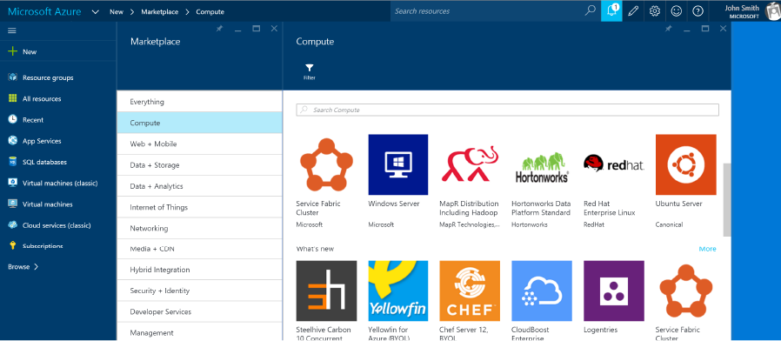
Virtual Machines
Choice of OS
Support for Linux, Windows Server, SQL Server, Oracle, IBM, and SAP
On-Demand
Create and deploy virtual machines in minutes
Scalable
Scale from one to thousands of virtual machine instances across regions

Slide 9
Visit
Azure.com to get started

Slide 10
Cross-Platform Web Development in Microsoft Azure

Slide 11
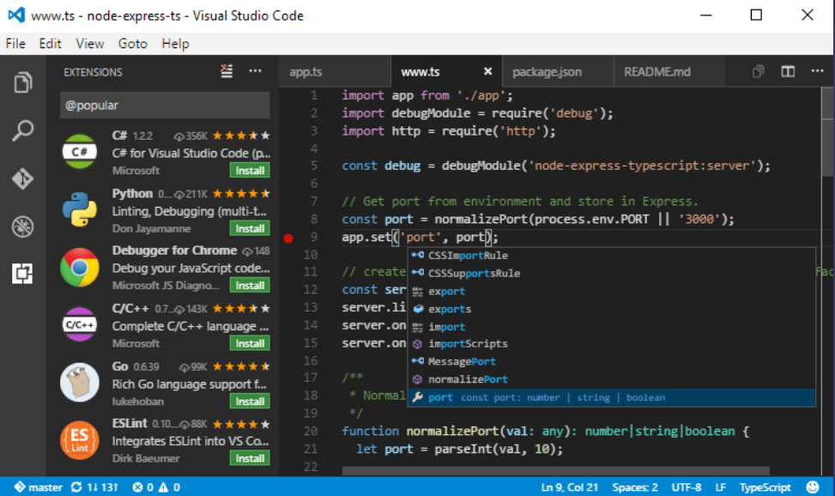
npm install -g azure-cli
VS Code & xplat-cli
Open-Source X-Platfom IDE
Code editor with support for development operations like debugging, task running and version control
Integrated Terminal Support
Access installed shells directly from VS Code
Azure-xplat-cli
cross-platform cli for developers and IT admins to develop, deploy and manage Azure apps
npm install -g azure-cli

Slide 12
Visit
https://code.visualstudio.com to get started

Slide 13
Cross-Platform App Development in Microsoft Azure

Slide 14


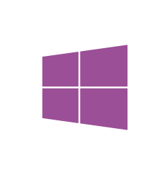

.NET and Xamarin
Share app logic across platforms
Native apps for Windows, iOS and Android devices using .NET
Most productive and powerful platform for creating native applications
Maximize code reuse with Universal Projects & Portable Class Libraries
100% APIs exposed
Everything you can do in xCode or ADT you can do with Visual Studio
z
Native UI
Native UI
Native UI
C# + XIB
C# + AXML
C# + XAML
Shared
client app C# logic

Slide 15
Visit
Xamarin.com to get started

Slide 16
Internet of Things Scenarios in Microsoft Azure

Slide 17
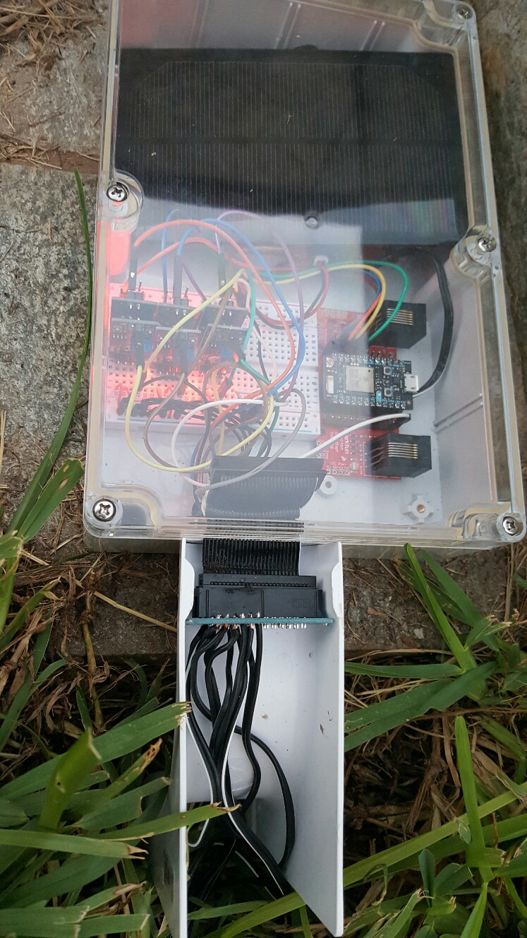
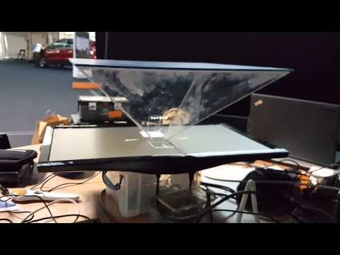
IoT Hacks
HelloHolo – Real Time Translating Hologram TechCrunch Disrupt 2015
Internet of Trees (aka.ms/internetoftrees)

Slide 18
Microsoft Azure IoT Suite
Azure IoT Suite Remote Monitoring Solution
Web/Mobile App
Power BI
Devices
DocumentDB
Back end systems and processes
Storage blobs
Simulator
IoT Hub
Stream Analytics
Event Hub
Web Jobs
Logic Apps
Azure
Active Directory

Slide 19
Visit
InternetofYourThings.com to get started

Slide 20
Cognitive Services & Bots in Microsoft Azure

Slide 21

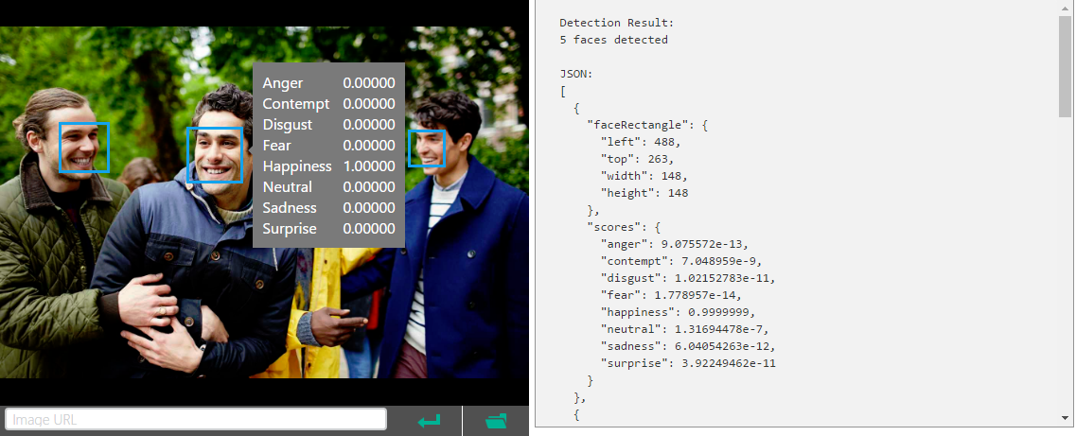
AI as a Service
Computer Vision
Computer Vision, Emotion, Face, Video
Speech
Speech to Text, Speech Recognition, Speaker Identification
Language
Spell Check, Language Understanding

Slide 22
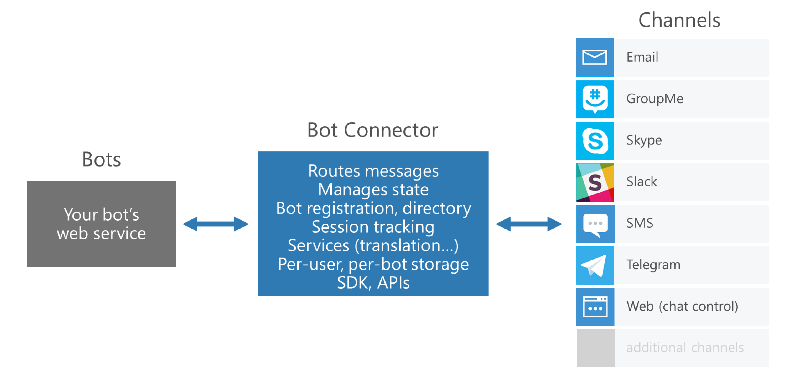

Slide 23
Visit
microsoft.com/cognitive-services to get started

Slide 24

